Slide 1
Everybody Wins!
Presented by:
Russell Randall, Coconino HS
Transition Facilitator
Developed by:
Russell Randall & Andrew Michael
Flagstaff Unified School District 2010

Slide 2


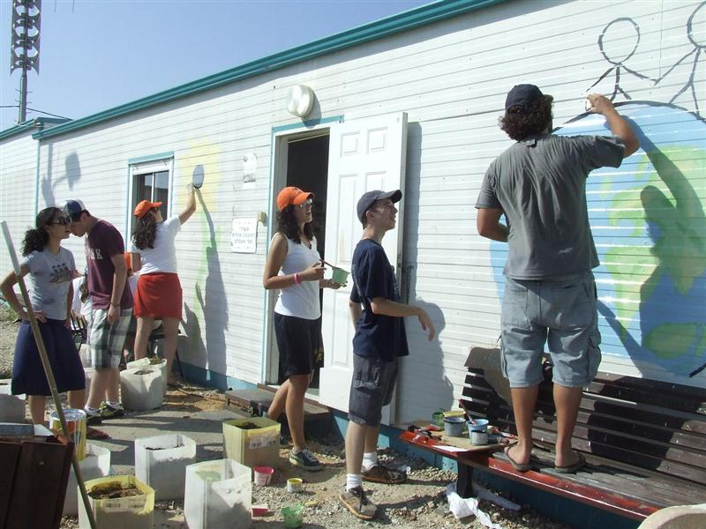
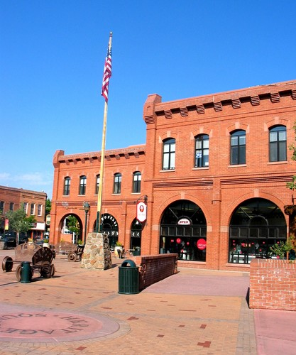
Why hire a student worker, especially one with a disability?
Because Everybody Wins: Students, Businesses, Schools & the Community!

Slide 3
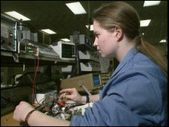
Program Philosophy
FUSD recognizes that students whose talents are limited in traditional academic areas may perform well, and even excel in other areas.
The Special Needs Work Experience Program offers students a vocational setting to assist them in realizing more fully their strengths and abilities while earning a credit, and often a paycheck.^

Slide 4
The FUSD Special Needs Work Experience Program
Provides work experiences for students with special needs so as to build upon students’ vocational skills for future success in the working world.
Some students are assisted with job shadowing opportunities.
Some students are assisted with supported employment opportunities.
Some students are assisted with competitive employment opportunities.
Students may earn school credit for a positive work experience. One credit may be granted for each 120 hours worked, assuming an average of 5-10 hours weekly. A maximum of two credits can be granted each semester or over the summer.^

Slide 5

Work Experience: Student Goals
The student worker will develop:
Communication Skills:
  Ability to communicate effectively with employer
  Ability to communicate effectively with co-workers
Job Search Skills:
  Ability to complete employment applications
  Ability to successfully complete employment interviews
Successful Work Experience:
  Ability to work independently
  Ability to maintain high level of motivation towards work
  Ability to perform at work so as to maintain a high level of employment^

Slide 6

Work Program: Student Responsibilities
Maintain positive, meaningful employment. The student is expected to hold the same job for the entire semester unless the work situation is discussed with and evaluated by the Transition Facilitator.
Work a minimum of 120 hours for one credit or 240 hours for two credits.
Submit pay stubs or a log of hours worked (signed by employer or work supervisor) so as to document hours worked.
Submit a minimum of two positive work evaluations (completed by employer or work supervisor) each semester. ^
(cont.)

Slide 7


Student Responsibilities (cont.)
To be prompt and dependable in attendance, both in school and on the job
To perform all job requirements and responsibilities to the best of his/her ability
To abide by all rules and regulations of employer
To provide his/her own means of transportation to the work site
To provide Transition Facilitator with necessary information about employer and/or place of employment
To meet with Transition Facilitator at least twice each semester to review work performance and evaluations^

Slide 8

FUSD Transition Facilitator’s Role
The primary function of the Transition Facilitator is to provide transition services to students with special needs.
Specific responsibilities include:
Assessing students’ transition needs and assisting case managers in providing for those needs
Developing job sites (including job shadows) and working relationships with employers in the community
Assisting students with job-seeking skills including resume’ development, letters of application, job applications, & interviewing skills
Assisting students with learning “soft skills” needed to achieve and maintain positive employment^
(cont.)

Slide 9
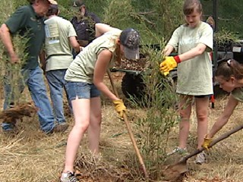

FUSD Transition Facilitator’s Role (cont.)
Communicating with employers to discuss student worker responsibilities, problems, progress, etc.
Providing worker supervision, coaching and other support to both the employer and the employee as needed
Counseling student workers regarding employment needs, problems, progress, evaluations, etc.
Awarding credit for work experience as is appropriate.
Assisting students in considering potential careers suited to their needs, interests and abilities^

Slide 10

Parents’ Role
To encourage their child/student to successfully perform his/her duties and responsibilities both in the classroom and on the job
To assist their child/student (as necessary) with work related logistical considerations including transportation, financial concerns (taxes, banking, etc.) time management, etc.
To monitor child/student’s hours worked, ability to manage school and work, stress level, etc.
To contact the Transition Facilitator with any questions or concerns.^

Slide 11

Employer’s Role
Provide job shadow and/or employment
Provide pay if student is competitively employed
Provide reasonable job responsibilities, reasonable job duties and reasonable job expectations to student worker
Provide supervision
Periodically evaluate student worker performance
Contact Transition Facilitator with questions or concerns^

Slide 12

Documentation
Students submit copies of timesheets, daily logs and/or pay stubs to the Transition Facilitators, who document hours worked and keep records for the program students on file.
“Work Experience Agreements” are used to ensure that all parties are knowledgeable of their respective responsibilities.
  Paid Work Agreement
  Unpaid (Supported or Job Shadowing) Work Agreement^

Slide 13

Pay
If student worker is in need of supported employment, payment for work performed can be provided by the student worker budget managed by the Transition Facilitator.
In competitive work environments, payment for work performed will be provided by the employer. Minimum wage laws apply.^

Slide 14
School Course Credit
The FUSD Special Needs Work Experience Program is a job skills training program. As such, its value exists in the training and experience received, as well as the pay.
Students enrolled in the program can receive elective course credit. This credit is awarded for growth and achievement displayed by the student related to employment skills.
Credit is awarded at a rate of 1credit per 120 hours worked, with a maximum of 2 credits per semester or summer.
In order to receive credit, the student worker must comply with the student responsibilities discussed previously. Of note, the student worker must receive positive evaluations from his/her employer.^

Slide 15



FUSD Student Worker Sites
Student worker positions have existed at the following FUSD sites:
*District Warehouse
*District Mail Room
*District Laundry
*District Print Shop
*District Bus Barn
*District Book Cage
*District Administrative Center
*Sinagua School- Little Ropers’ Daycare
*Flagstaff High School- The Kids’ Center Daycare
*District School Campus Sites:
*Cafeteria Work
*Library work
*Custodial Work
*Clerical Work^

Slide 16

Current Supported Employment Placements
Goodwill Industry of Northern Arizona
Southwest Food Services
Northern Arizona University
St. Mary’s Food Bank
SAVERS
Second Chance Pets
Lil’ Ropers’ Day Care
Northland Hospice
Flagstaff Public Library
Flagstaff Parks & Recreation
On campus placements
( including CHS, FHS, Killip & Puente de Hozo)

Slide 17

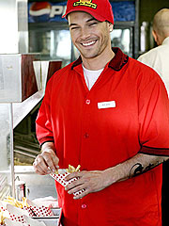

Current Competitive Employment Placements
Flagstaff Mall
Taco Bell
Burger King
McDonald’s
Target
Wal-Mart
Bashas’
Safeway
Fry’s
Albertson’s
Sam’s Club
Other business placements…….

Slide 18
Insurance
The Flagstaff Unified School District insurance program follows a student to his/her place of employment.
The district can supply your business with a Certificate of Insurance for all students involved in either competitive or supportive employment at your business.
The Technical Information Bulletin below contains relevant information from both Federal and State regulations regarding Student Work Programs:
  AZ Risk Retention Trust Bulletin #23

Slide 19


Why Hire Youth?
Myths & Realities about Youth Employees
Myth: Young workers are hard to train.
Reality: Youth are usually flexible and take to training well.
Myth: Young people have poor work skills.
Reality: Skills are different than qualities. When interviewing youth, define qualities you are looking for. Skills can be taught.
Myth: Young people are unmotivated towards work.
Reality: Young workers are just starting a lifetime in the workplace. Most are very enthusiastic about taking on adult responsibilities, earning their own money, establishing independence, etc. ^
(cont.)

Slide 20
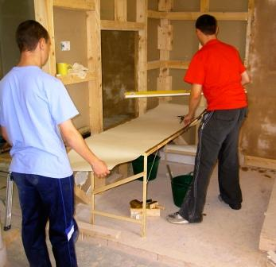
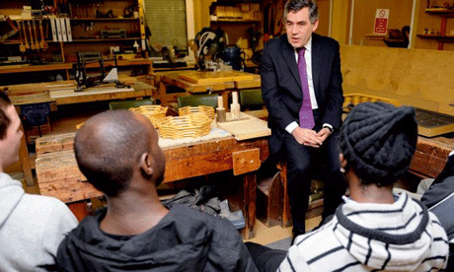
Myths & Realities (cont.)
Myth: Young workers don’t take feedback well.
Reality: Young workers need more feedback than do adults, but they are also accustomed to receiving it from parents, teachers, etc.
Myth: It’s hard to find good young workers.
Reality: Many young people today are looking for meaningful employment. Also, youth tend to be networked (through school, teams, church groups, Facebook, Craig’s List, etc.) better than potential adult workers.
Myth: Youth have a short attention span and are undependable.
Reality: Youth can attend very well (if motivated to do so) and dependability is a learned skill.^

Slide 21


Value in Hiring Youth
Employment provides a young person the opportunity to shine, perhaps for the first time!
Employment provides a young person the experiences needed to be a competitive and productive employee now and in the future.
Employment provides a young person a vocational setting where he/she may realize his/her true strengths and abilities.
Youth are eager to learn new skills
Youth make good trainees (usually they have fewer preconceived notions about the workplace than adults)^
(cont.)

Slide 22


Value in Hiring Youth (cont.)
About 1 in 5 Americans are under the age of 21. Young workers represent a large segment of our society, a segment that often has disposable income.
Young consumers enjoy interacting with young workers.
Trained young workers tend to be loyal to their employers, both as workers and as consumers.
Youth are usually up to date on the latest technology.
Youth are usually less expensive to hire than are adults.
Youth tend to have a lot of energy.^

Slide 23

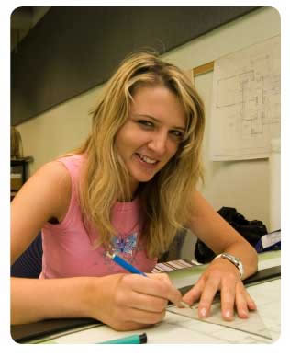
Why hire people with Disabilities?
Myths & Realities about People with Disabilities
Myth: People with disabilities are a small segment of the U.S. population.
Reality: People with disabilities are the largest single minority group (between 25 and 30% of the population) in the country.
Myth: Disabilities are unusual, permanent, medical conditions.
Reality: Disabilities are extremely common and are experienced by almost everyone at some time. Many disabilities are temporary and most do NOT have a physical aspect.
Myth: People with disabilities are limited in the work they can do.
Reality: We are ALL limited in the work we can do. Considering the ABILITIES of all workers increases productivity.^
(cont.)

Slide 24
Myths & Realities (cont.)
Myth: Job performance and productivity of workers with disabilities is lower than that of other workers.
Reality: A 30 year study by DuPont found that “Job performance and productivity by workers with disabilities exceeded fully functioning peers.”
Myth: Employees with disabilities are more likely to be absent from work and will experience safety problems.
Reality: Employees with disabilities have above-average safety and attendance records . People with disabilities are also more likely to be loyal to the employer who hires and trains them. (DuPont)
Myth: Employees with disabilities will increase employers’ insurance costs.
Reality: Federal law outlaws this. Also, FUSD covers all student workers. Lastly, the Work Incentives Improvement Act (1999) allows workers with disabilities to continue their Medicaid benefits when employed.
Myth: Employees with disabilities will be difficult to integrate efficiently into the workplace.
Reality: Workplaces integrating people with disabilities report increased camaraderie, collegiality and cooperation among all employees. (DuPont)^

Slide 25

Value in hiring someone with a disability
Diversifying your workforce: 30% of the community have experienced a disability of some sort. By diversifying your workforce to reflect the community, you can improve access to a significant segment of the market as well as improving public image and links with the community.
Technology. Innovation and global competition have created more individualized relationships with consumers. Understanding disabilities will assist businesses in providing individualized services.
Flexibility and Competence: Businesses need workers with a demonstrated ability to adapt to different situations and circumstances. People with disabilities daily are faced with unique challenges that require complex solutions. In the workplace this resourcefulness translates into innovation.^
(cont.)

Slide 26
Value in Hiring Someone with a Disability (cont.)
Most employees with disabilities do NOT require accommodations to be successful at work. If they do, the cost of these accommodations are often remunerated by the government.
Productivity rates (including work quality and task consistency) are as good or better for people with disabilities compared to other workers. (Virginia and Commonwealth University)
Due to increased attention to detail, workers with disabilities have better than average safety records at work. (DuPont)
Workers with disabilities average 5.1 years of employment with the same employer compared to 3.2 years for their non-disabled peers (U.S. Dept. of Labor)
Workers with disabilities average 6.8 days absent annually, about half that of their non-disabled peers. (U.S. Dept. of Labor)^

Slide 27
Financial Incentives
Rehabilitation Act of 1973: Authorizes federal funding (from the Rehabilitation Services Administration) to state Vocational Rehabilitation (VR) agencies to assist people with disabilities as they prepare for and enter the work force. VR can assist with barrier removal and provision of accommodations, can provide on-the job training and can share in the payment of wages for an employee with disabilities.
The VR staff can also assist employers with recruitment of workers with disabilities, can conduct job analyses and can provide disability awareness training for company personnel.
(contact your local Vocational Rehabilitation agency (928-779-4147) or see https://www.azdes.gov/rsa )^ (cont.)

Slide 28
Financial Incentives (cont.)
Work Opportunity Tax Credit (WOTC): This is a federal tax credit incentive that Congress provides to private-sector businesses for hiring individuals from 12 target groups who have consistently faced significant barriers to employment. “Disconnected” youth and workers with disabilities are 2 of the target groups.
(see http://www.doleta.gov/business/incentives/opptax/ )
Disabled Access Credit (DAC): The Omnibus Budget Reconciliation Act contains a tax incentive to encourage small businesses to comply with the Americans with Disabilities Act. Included are expenditures for removal of barriers for employees with disabilities, providing interpreters and other accommodations, modifying equipment, etc.
(see your local Internal Revenue Service Office or http:www.irs.gov/businesses)

Slide 29

What the FUSD Student Worker Program provides…
Competent and convenient assistance in receiving student worker referrals
  Access to an expanded labor pool
  Recruitment assistance
  Prescreening of applicants
  Assistance with employment paperwork
Matching of student worker skills and interests to employment positions and job duties
  Formal and informal assessment of potential student workers
  Knowledge of student worker capabilities and interests
  Understanding of employers’ circumstances and needs
  Identification of tasks important to employer and student worker
  Customization of tasks, if necessary
  Provision of on-the-job accommodations, if necessary (cont.)

Slide 30
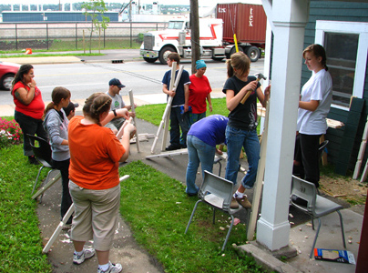
What the program provides (cont.)
Timely support in training, supervising and monitoring student workers
  Job skill training of pre-employment student workers
  Job shadowing of future positions by pre-employment student workers
  Job coaching for newly hired student workers
  Assistance with supervision
  Formal evaluation procedures
  Assistance if a problem with a worker arises
  Processing of employers’ feedback
  Pay for the student worker, if necessary
Formal and informal disability awareness
  Disability awareness information
  Information about providing accommodations
  A model for appropriate support and social interaction for youth with disabilities

Slide 31

Benefits for the Employer
Display of positive corporate citizenship
Diversification of current workforce
Development of future workforce in areas of specialized needs
Expansion of business outreach to under-represented communities
Expansion of formal mentoring of new employees (leading to increased employee loyalty, reduction in learning time and costs associated with the hiring of new employees, and expanded leadership development in employees.)
Assistance in training, coaching and supervising new employees
Potential financial incentives and support from governmental agencies.
The student worker may be paid from the FUSD student worker budget
( also please see previous slides “Value in Hiring Youth” and “Value in Hiring Someone with a Disability” )^

Slide 32



Benefits for the Student Worker
Growth in self confidence
Opportunity to develop work place skills
Learning about disability disclosure
Growth in self advocacy skills related to accommodations
Identification and clarification of potential career interests
Opportunity to learn about work place culture and expectations
Potential for long-term positive and meaningful employment
Connection of school learning with real-life application^

Slide 33




Why hire a student worker?
Because everybody wins!
Thank You!

Slide 34
Resources & Links
U.S. Department of Labor, Office of Disability Employment Policy (ODEP)
  1-866- 633-7365 http://www.dol.gov/odep/pubs.htm
  ODEP is a US Department of Labor agency that provides national leadership to increase corporate opportunities to adults and youth with disabilities.
Arizona Developmental Disabilities Planning Council
http://www.azgovernor.gov/DDPC/
DisabilityInfo.gov Employer Resources Page
http://www.disabilityinfo.gov/digov-public/DisplayPage.do?parentfolderID=11
Vocational Rehabilitation (VR)
(928)774-4147
State VR agencies can help employers identify qualified, job-ready candidates with disabilities to fill their workforce needs.
Job Accommodation Network (JAN)
1-800-526-7234
JAN is a free consulting service from ODEP that provides individualized accommodation solutions and technical assistance regarding the ADA and other disability-related legislation.
(cont.)

Slide 35
Resources and Links (cont.)
Centers for Independent Living (CIL)
http://www.ncil.org
CILs are community-based, nonprofit organizations that improve opportunities for people with disabilities to live independently and productively.
National Center on Secondary Education and Transition (NCSET)
http://www.ncset.org
Includes national resources, technical help and information related to secondary education transition for youth with disabilities.
New Ways to Work
http://www.nww.org
Links to tools and guides, as well as a training curriculum for staff on work-based learning and a quick guide on safety and child labor laws.
Disability Employment Guide
http://www.ed.gov/about/offices/list/osers/products/employmentguide
(cont.)

Slide 36
Resources and Links (cont.)
Disability and Business Technical Assistance Centers (DBTACs)
http://www.adata.org/dbtac.html
DBTACs offer information and assistance to employers with responsibilities under the Americans with Disabilities Act (ADA).
DisabilityInfo.gov
http://www.disabilityinfo.gov
Contains a broad array of disability-related information, including information on tax credits to offset potential accommodation cost.
Disability Awareness Information Kit
http://www.openroad.net.au/access/dakit/disaware/disaware/disawarecontent.htm
Employer Assistance and Resource Network (EARN)
1-866-EARN-NOW (1-866-327-6669)
EARN is a free service that connects employers looking for quality employees who are skilled job candidates. EARN, which is a service of ODEP, can also provide technical assistance on general disability employment-related issues.

Slide 37
Contact Information
Erin Galland
Flagstaff HS Transition Facilitator
401 Elm Flagstaff AZ 86001
(928) 773-8100 egalland@fusd1.org
Russ Randall
Coconino HS Transition Facilitator
2801 N. Izabel Flagstaff AZ 86004
(928) 773-8225 rrandall@fusd1.org
Diana Shaum
Director, FUSD Student Support Services
3285 E. Sparrow Ave. Flagstaff, AZ
(928) 527-6171 dshaum@fusd1.org

